Slide 1
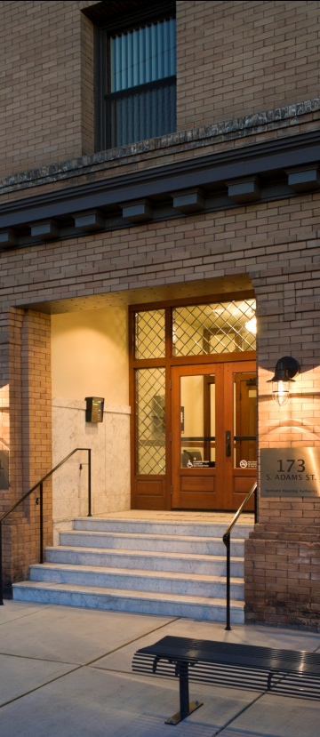
Sustainability and Historic Preservation
Washington State Department of Archaeology and Historic Preservation
Executive Summary 2011
“Old ideas use new buildings; new ideas use old buildings.” – Jane Jacobs
energy efficiency
improved and reused infrastructure
salvage and recycle
local products, materials and labor
healthier environments
reduced construction and demolition waste
reuse, repair and renewal

Slide 2
Preservation of our historic built environment…
Reduces resource and material consumption
Puts less waste in landfills
Consumes less energy and resources than demolishing buildings and constructing new ones
Provides environmental, cultural, and economic benefits for communities

Slide 3
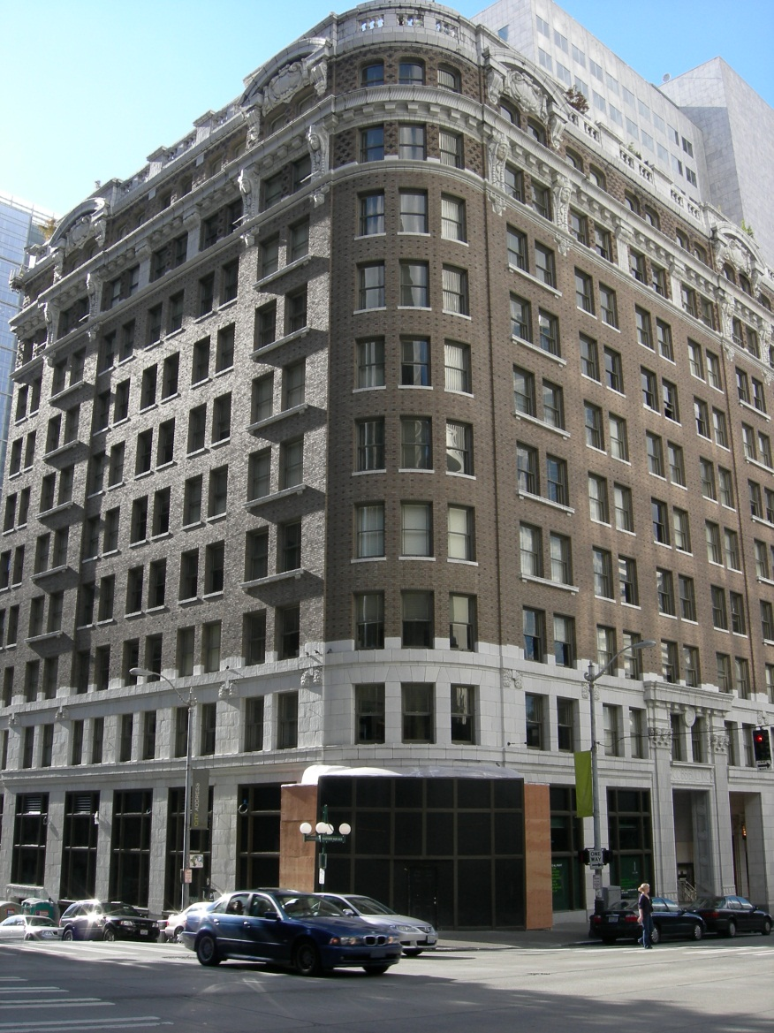
Our built environment consumes enormous amounts of resources
43% of carbon emissions and 39% of total U.S. energy use is attributed to building construction
This includes building operation and maintenance
This does not include greenhouse gas emissions from manufacturing building materials and products

Slide 4
Historic Buildings are a valuable, existing resource
Demolition and new construction consumes vast amounts of energy and materials
Building related construction and demolition debris comprise 2/3 of all non-industrial solid waste in the U.S.
Average building demolition yields 155 pounds per square foot of waste
Average new construction projects yield 3.9 pounds per square foot of waste
Each year in WA, almost 1.4 million tons of debris ends up in our landfills, most of which comes from new construction and demolition projects

Slide 5
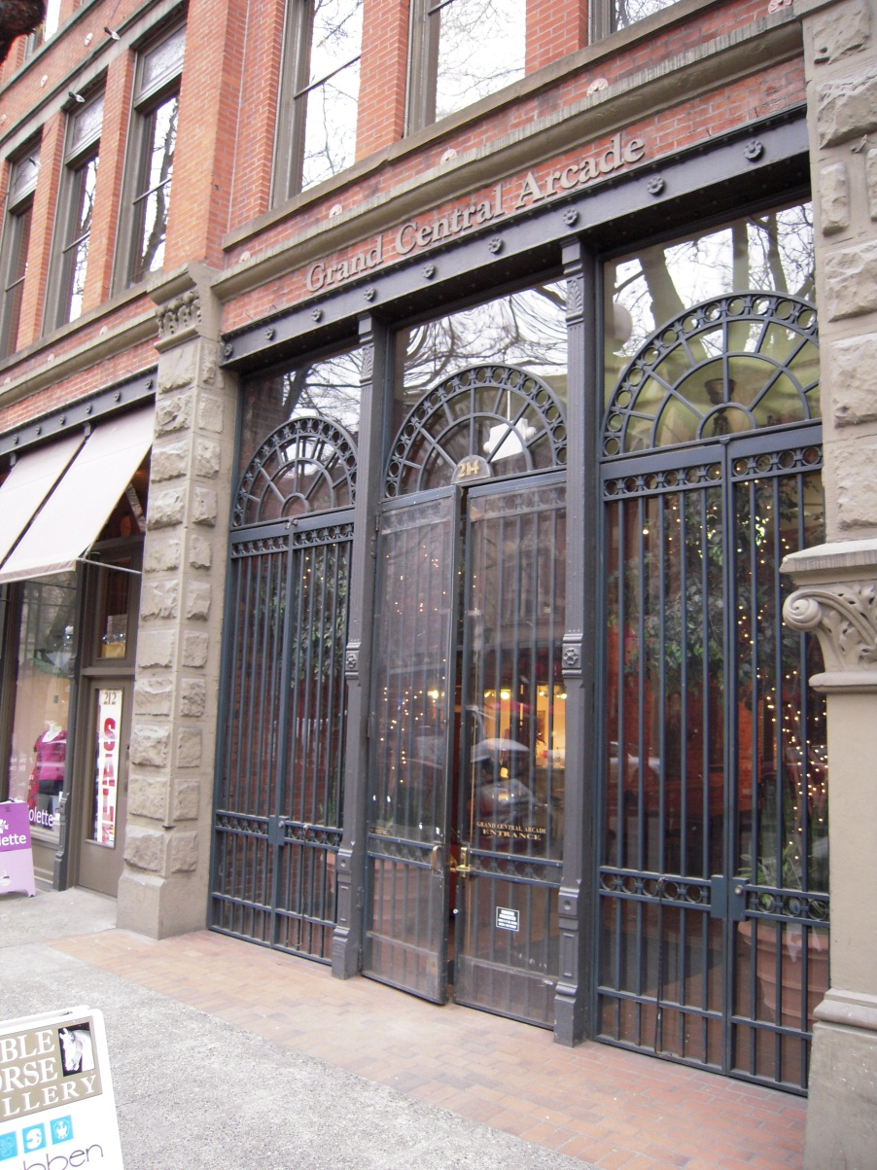
Preserving Historic Buildings conserves energy and resources
Embodied energy is the measurement of energy used in the process of building, from extraction of raw materials to final installation of the finished material
Approx. 80 billion BTUs of energy are embodied in a 50,000 sf building (about 640,000 gallons of fuel)
Estimated 730,000 gallons of fuel needed to demolish and reconstruct the Grand Central Arcade Building in Seattle’s Pioneer Square Historic District
Additional expended energy is wasted when an existing building is demolished and replaced with new construction

Slide 6
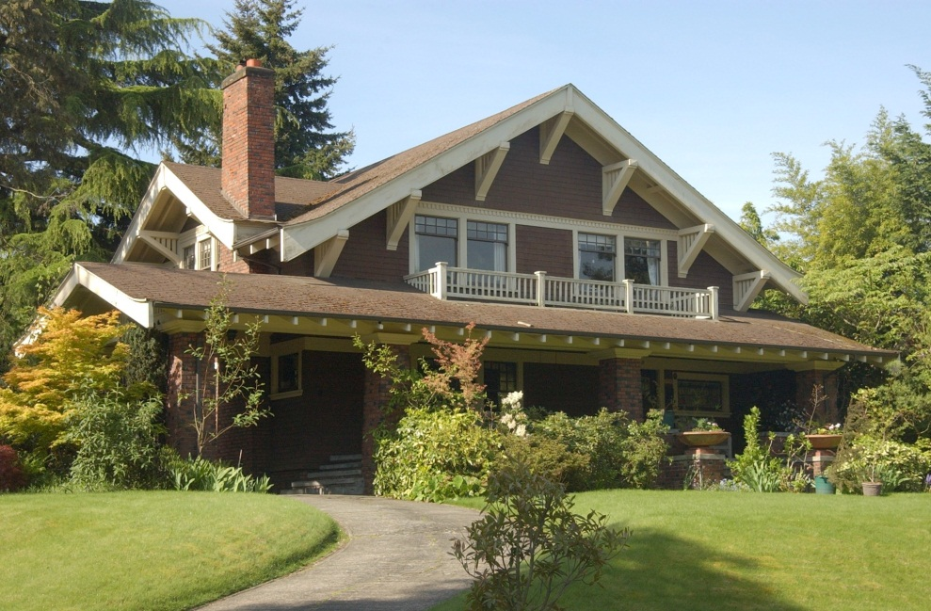
Historic Buildings can be Energy Efficient
U.S. Dept. of Energy data indicates that commercial buildings built before 1920 use less energy per square foot than buildings from any other decade up until 2000
WHY?
Historic buildings were designed to use passive heating and cooling (i.e. natural daylighting, ventilation, solar orientation) systems
Historic buildings used natural materials to a larger degree, were more durable, locally sourced, needed less processing, and are easier to maintain
Notes:
The Importance of Downtowns - Why should we revitalize them?
Employment Center:
Tax base: compare DT's to the value of the balance of the community. Downtown represents substantial tax base
Shopping and service center: The CBD is an essential area, CANNOT be with out retail and just be a service center. DT's are best as mixed-use developments areas, many with 24-hour activity.
Historic area: This is the core of the community. The point at which the city began to grow from. What makes your community special.
Private and public investment: Downtown/historic commercial district building owners have let the value of the real estate decline while residential real estate has not been allowed to decline.
Tourism draw: Unique shops, atmosphere, location, relation to natural resources. (shopping, history, natural resources)
Government center: Court Houses, Post Offices, City Hall, Federal Buildings, etc.
Downtown provides the city or village with a sense of community and place. These are quality of life issues.

Slide 7
Repair, Restore and Maintain- Not Replace -Historic Windows, Doors, Siding, etc.
Only 10% of energy loss in a home is through windows
Maintaining and repairing historic windows combined with appropriate devices can be cost effective and energy efficient
Re-using windows reduces landfill debris and environmental impacts of manufacturing new windows
New windows last 10-20 years on average, are not biodegradable nor easily recycled
Notes:
Main Street™ is a philosophy, a program, and a proven comprehensive approach to downtown commercial district revitalization. This approach has been implemented in over 1,200 cities and towns in 40 states across the nation with the help of the National Main Street Center and statewide downtown revitalization programs.
The success of the Main Street™ approach is based on its comprehensive nature. By carefully integrating four points into a practical downtown management strategy, a local Main Street™ program will produce fundamental changes in a community's economic base:
Organization involves building a Main Street™ framework that is well represented by business and property owners, bankers, citizens, public officials, chambers of commerce, and other local economic development organizations. Everyone must work together to renew downtown. A strong organization provides the stability to build and maintain a long-term effort.
Promotion creates excitement downtown. Street festivals, parades, retail events, and image development campaigns are some of the ways Main Street™ encourages customer traffic. Promotion involves marketing an enticing image to shoppers, investors, and visitors.
Design enhances the attractiveness of the business district. Historic building rehabilitation, street and alley clean-up, colorful banners, landscaping, and lighting all improve the physical image of the downtown as a quality place to shop, work, walk, invest in, and live. Design improvements result in a reinvestment of public and private dollars to downtown.
Economic Restructuring involves analyzing current market forces to develop long-term solutions. Recruiting new businesses, creatively converting unused space for new uses, and sharpening the competitiveness of Main Street's traditional merchants are examples of economic restructuring activities.

Slide 8
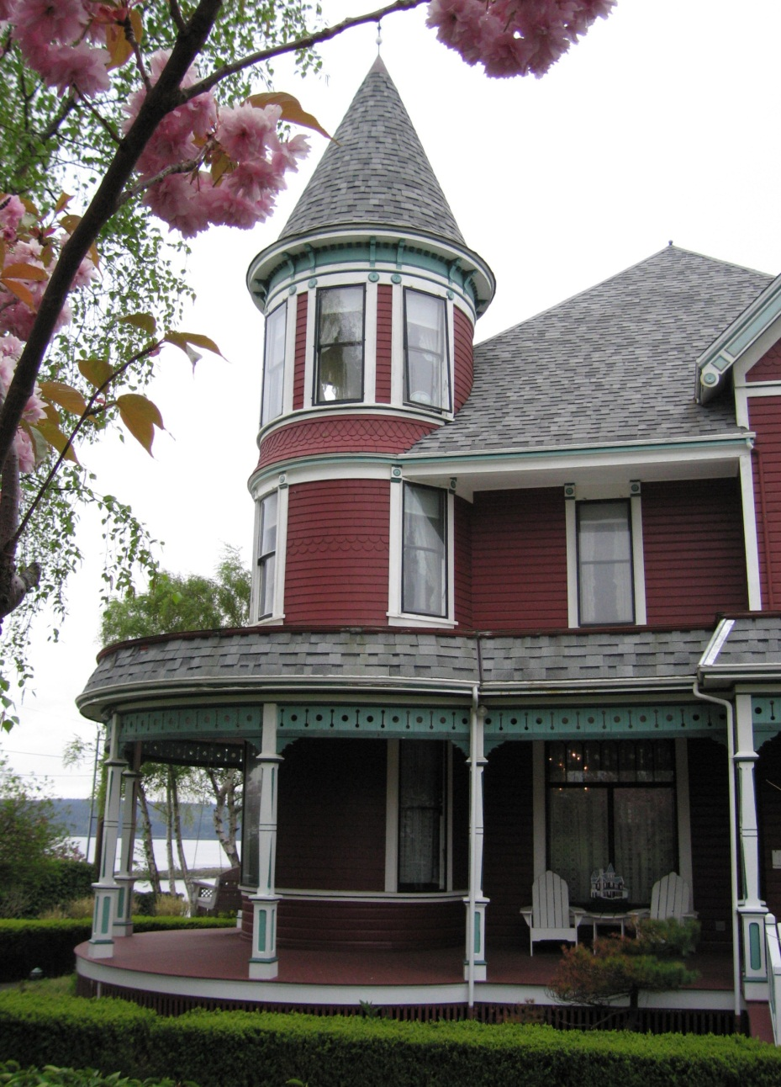
The Secretary’s Standards for Rehabilitation + Energy Efficiency=Compatible?
Yes!
The Standards provide guidance for appropriate rehabilitation of historic building while allowing for updates and modern amenities
Energy efficiency measures and green building standards can be compatible with the Standards
Using qualified preservation professionals, early consultation in the design process, and thorough understanding of preservation and “green” building issues can lead to “win-win” designs for preservation and sustainability
Notes:
1.Comprehensive. A single project cannot revitalize a downtown or commercial neighborhood. An ongoing series of initiatives is vital to build community support and create lasting progress.
2. Incremental. Small projects make a big difference. They demonstrate that "things are happening" on Main Street and hone the skills and confidence the program will need to tackle more complex projects.
3. Self-Help. The State can provide valuable direction and technical assistance, but only local leadership can breed long-term success by fostering and demonstrating community involvement and commitment to the revitalization effort.
4. Public/Private Partnership. Every local Main Street™ program needs the support and expertise of both the public and private sectors. For an effective partnership, each must recognize the strengths and weaknesses of the other.
5. Identifying and Capitalizing on Existing Assets. Unique offerings and local assets provide the solid foundation for a successful Main Street™ initiative.
6. Quality. From storefront design to promotional campaigns to special events, quality must be instilled in the organization.
7. Change. Changing community attitudes and habits is essential to bring about a commercial district renaissance. A carefully planned Main Street™ program will help shift public perceptions and practices to support and sustain the revitalization process.
8. Action Oriented. Frequent visible changes in the look and activities of the commercial district will reinforce the perception of positive change. Small, but dramatic, improvements early in the process will remind the community that the revitalization effort is underway.

Slide 9
Next Steps?
1
New, innovative building codes should be developed and adopted that better integrate preservation with energy efficiency based on performance rather than prescriptive requirements.
building codes
new partnerships
education
more research
planning

Slide 10
Next Steps
2
New partnerships and collaboration should be established between historic preservation groups, government officials, policy makers, and green designers and builders in order to increase the number of rehab projects that successfully demonstrate historic preservation as a sustainability tool.
building codes
new partnerships
education
more research
planning

Slide 11
Next Steps
3
Expand education efforts to all levels of educational institutions, including professional continuing education, that presents historic preservation as a sustainability tool and “green building” practice.
building codes
new partnerships
education
more research
planning

Slide 12
Next Steps
4
Historic building energy performance needs more research so that decisions to repair and maintain rather than replace are based on both hard data as well as historic character.
building codes
new partnerships
education
more research
planning

Slide 13
Next Steps
5
Expand planning for sustainable development to include not only rehabilitating historic buildings, but also conservation of existing neighborhoods, commercial centers, and rural landscapes.
building codes
new partnerships
education
more research
planning

