Slide 1
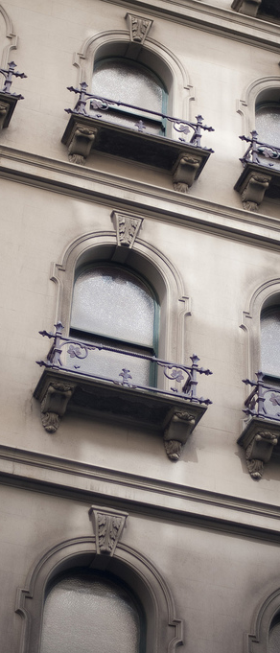
Retrofitting Historic Windows
10 Things You Should Know About Repairing and Reusing Historic Windows
Photo courtesy of Creativity103, Flickr

Slide 2
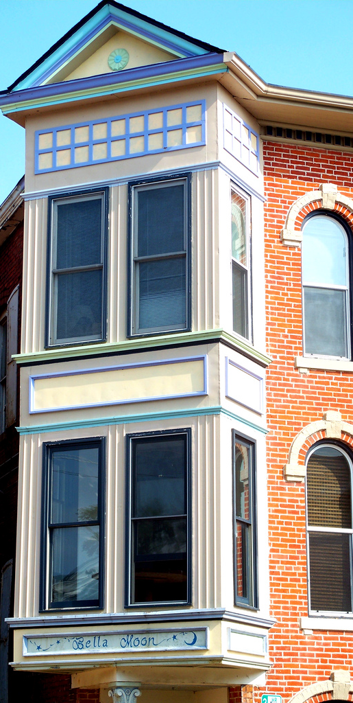
1. Consider their value.
Before retrofitting or replacing older windows, ask:
Are my windows an important architectural or defining feature of my building?
Are there ways I can retrofit my windows to achieve greater energy efficiency?
Will replacement windows fit the character of my property or detract from it?
Photo courtesy of Jo Naylor, Flickr

Slide 3
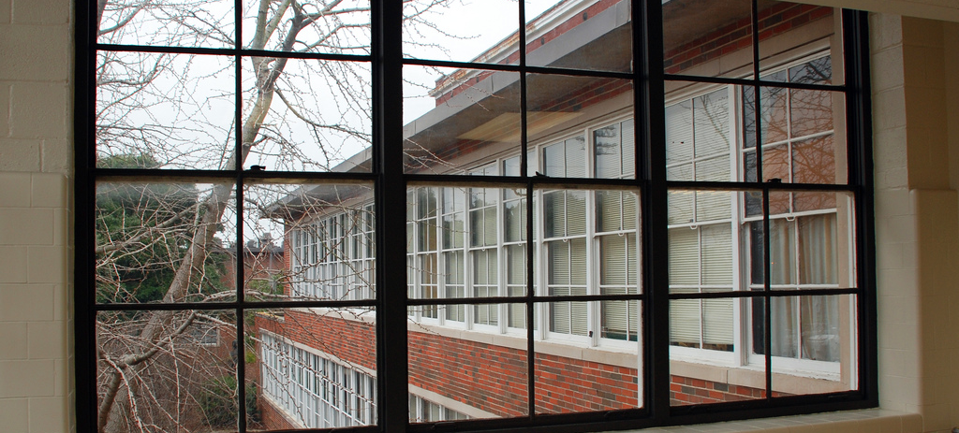
2. Tackle other energy-efficiency measures first.
Photo courtesy of Max Wolfe, Flickr
Make windows a part of your whole-house solution. First do an energy audit, then see what you can gain or save with window retrofits.

Slide 4
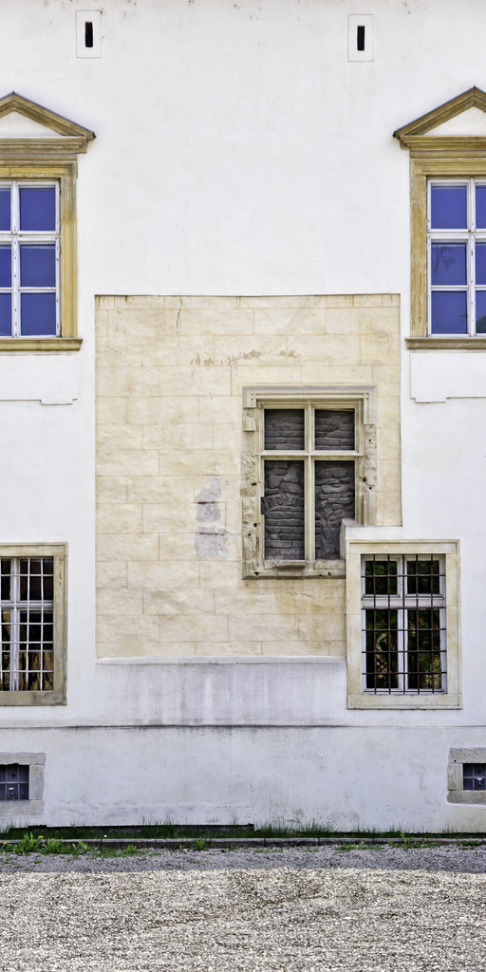
3. Retrofits = better ROI.
Retrofits achieve energy savings comparable to replacement windows, and at a much lower cost. Replacement windows have substantial upfront costs that aren’t rapidly recouped through energy bill savings.
Photo courtesy of Horia Varlan, Flickr

Slide 5
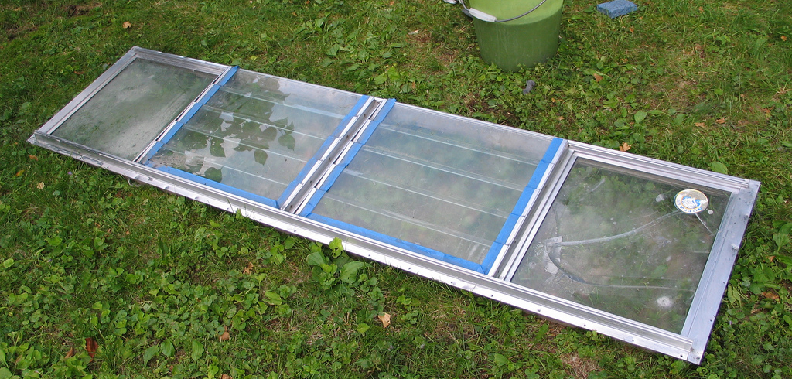
4. Retrofit performance varies.
Interior window panels, exterior storm windows, and insulating shades perform best. Weather-stripping has a better return if done as a DIY project. Performance varies by climate for all measures.
Photo courtesy of dwstucke, Flickr

Slide 6
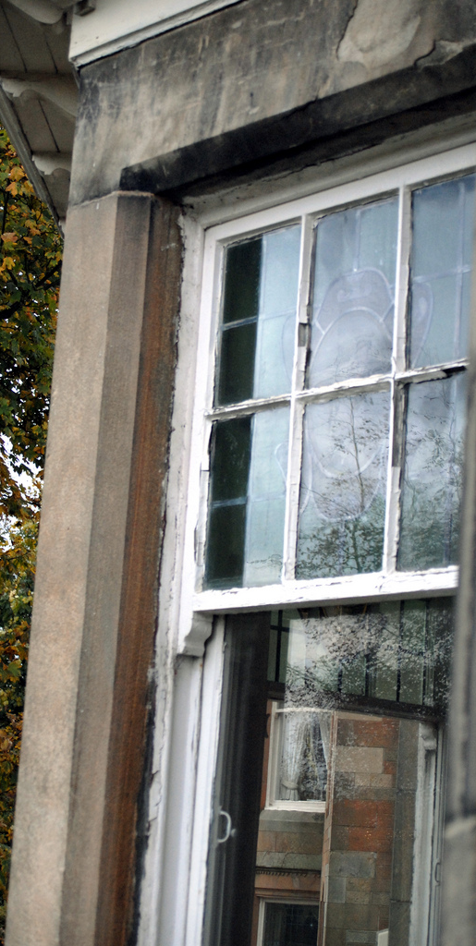
5. Consider climate.
Need help with heating? Install insulating cellular shades to reduce heat loss. Need help with cooling? Check to see what exterior shading (trees, other buildings, etc.) already exists around your property.
Photo courtesy of williefogg, Flickr

Slide 7
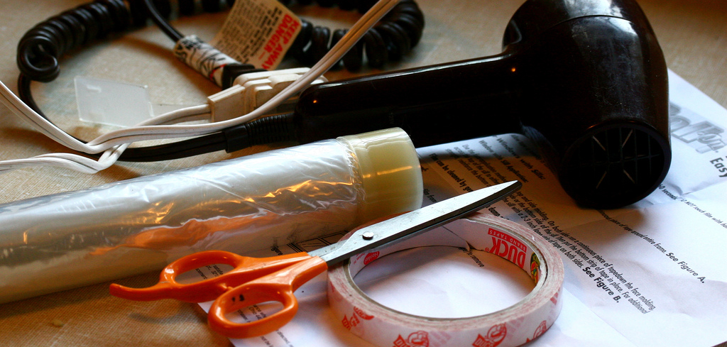
6. Take matters into your own hands.
Perform high-return, do-it-yourself installations first, where possible. Taking a phased approach to window upgrades can eventually lead to long-term savings of money, energy, and carbon emissions for older homes, even on a tight budget.
Photo courtesy of Muffet, Flickr

Slide 8
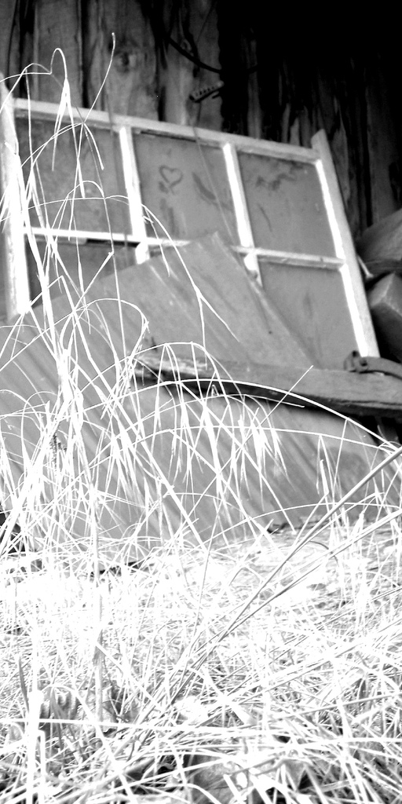
7. Saving windows is green.
Keeping existing windows saves the energy and resources needed to create new windows. Retrofit measures are often less materials-intensive and so impact the environment less than an entire window replacement.
Photo courtesy of wheat_in_your_hair, Flickr

Slide 9
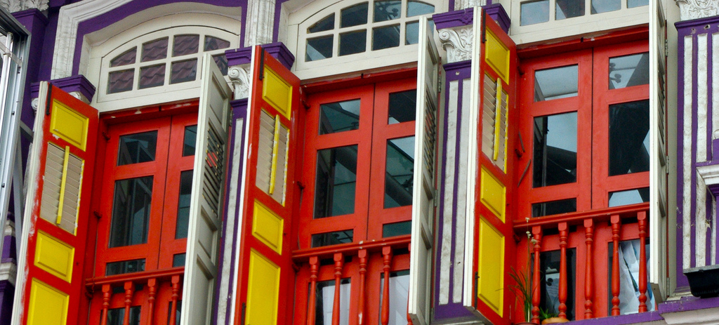
8. Older windows preserve character.
Photo courtesy of L. Allen Brewer, Flickr
Historic windows were custom fit to their original openings. Replacing them usually requires changing the size and/or shape, which compromises a home’s character and historic integrity -- and can reduce energy savings.

Slide 10
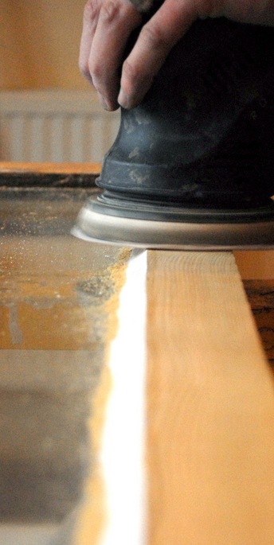
9. Older windows use better materials.
Wood windows made prior to the 1940s are likely to be made from old growth wood -- a stable, dense wood that mills well, holds paint and stain well, is not as attractive to insects, and has natural rot resistance.
Also, the wood was most likely harvested locally, making it better suited for local climate conditions.
Photo courtesy of williefogg, Flickr

Slide 11
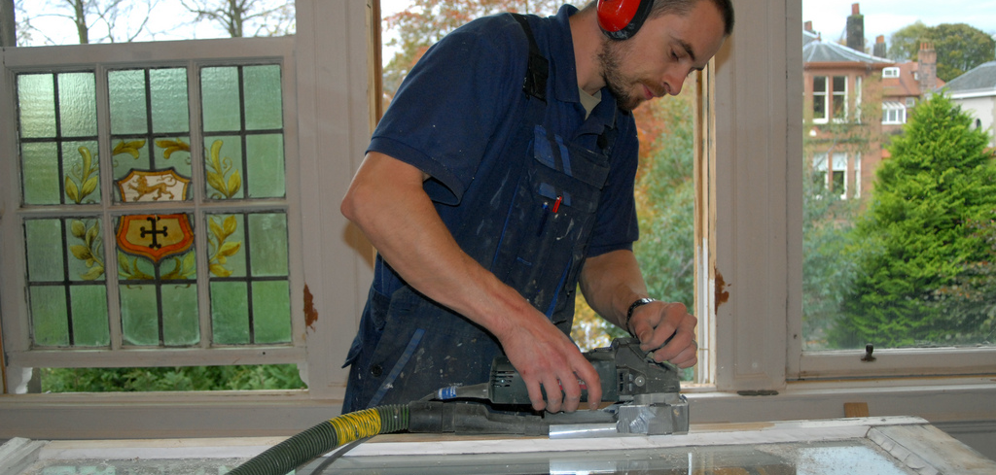
10. Older windows can be repaired.
Traditional windows are made from individual parts, so each piece can be individually repaired or replaced in kind. New windows, on the other hand, are manufactured as a unit; when one part fails, the entire unit must be replaced.
Photo courtesy of williefogg, Flickr

Slide 12
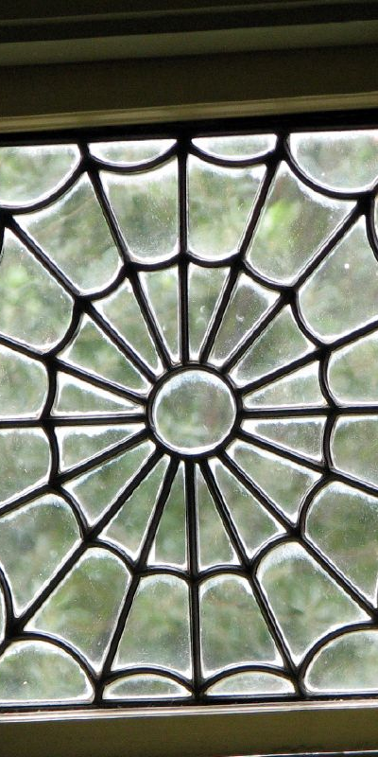
Want more information?
Check out Preservation Green Lab’s report Saving Windows, Saving Money: Evaluating the Energy Performance of Window Retrofit and Replacement at: http://www.preservationnation.org
/saving-windows-saving-money
Photo courtesy of Just Chaos, Flickr

